Slide 1

CAR PRICE PREDICTION
Submitted by – Haindavi Chakravarthy
Internship - Batch.no. 23

Slide 2
Contents:
Introduction
Analytical Problem framing
Analysis a) Preprocessing
b) Visualization
c) Treating Outliers
d) Treating Skewness
e) Model Building
Conclusion
Limitations of this work and Scope for the Future

Slide 3
Introduction:
With the covid 19 i9+mpact in the market, we have seen lot of changes in the car market. Now some cars are in demand hence making them costly and some are not in demand hence cheaper.
Predicting the price of used cars is both an important and interesting problem. The market value is based on a number of factors, including demand, supply, options, and incentives. The market value of a vehicle usually falls somewhere between the sticker price and the invoice price. Because the market value is an average, some people will pay more than that amount, while others will pay less.
A car's value is determined by many factors: the popularity of the make and model of your car, vehicle specifications, trim levels, physical appearance, mileage, consistent maintenance and working condition.
Using this as a base, I have collected the data from “Cars24” website and here I have collected and scrapped the information of the cars with definite and significant features required for predicting the better model
Once the data is collected, the data will be cleaned and pre-processed with all the necessary tools and the same will be used to build machine learning models in order to predict the price of the same

Slide 4
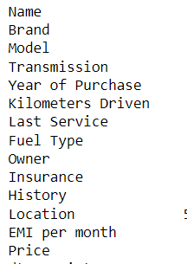
Analytical Problem Framing:
Here our dataset has 7039 rows and 16 columns, using this dataset we will be building the model followed by training the data and then finally the model is tested by using 70% of the training data and 30% of the testing data.
As we have pre-processed the data by removing the null values there may be chances of getting outliers and certain unknown values.
The following are the columns or features of our dataset:
These columns are named when the data is collected but during the pre-processing there are few newly created columns which are extracted from the existing data and thus the number of columns increased and the columns are renamed.

Slide 5
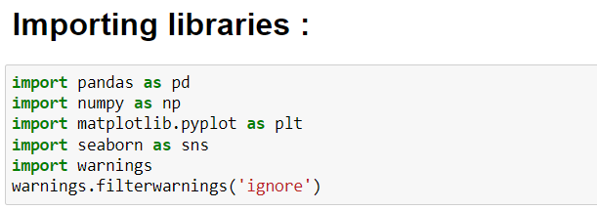
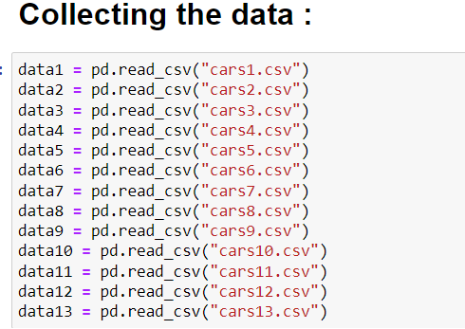
Analysis:
Primarily these are the basic libraries which are imported and further the libraries necessary are imported.
Here we have just collected the scraped data into different dataframes which needs to be concatenated for the complete dataframe

Slide 6
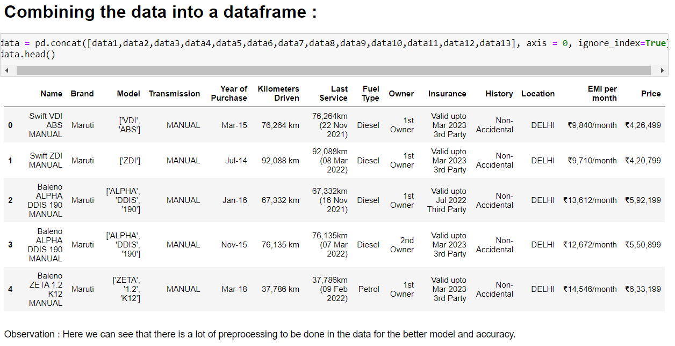
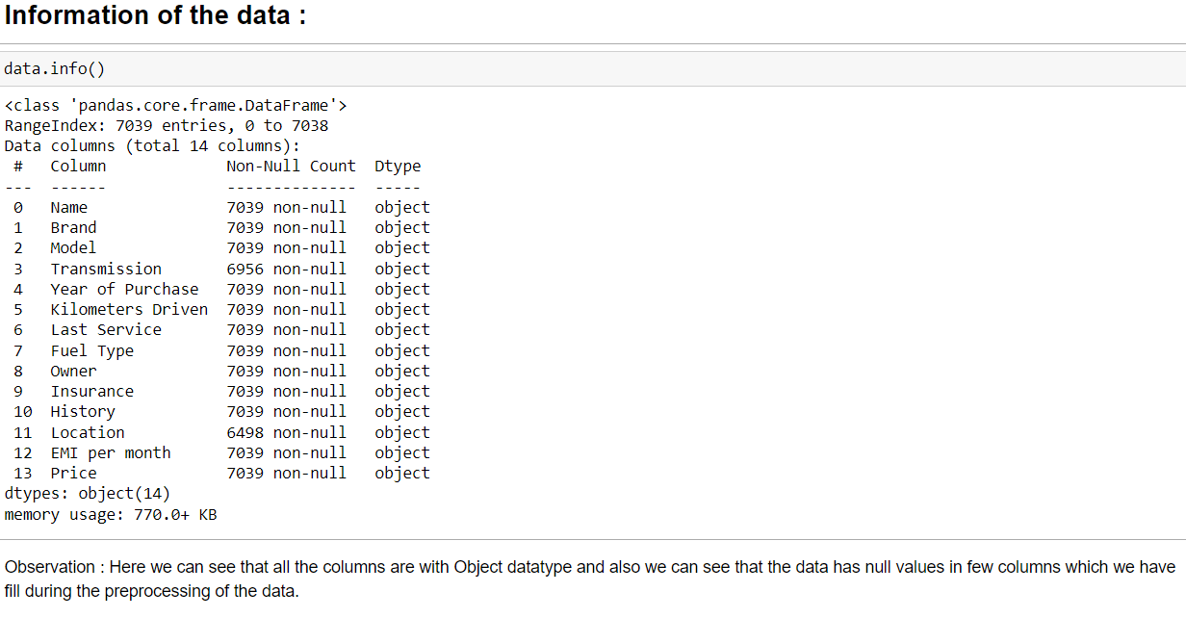
Here the data is concatenated and the dataframe is formed.
Here we have the null values in few columns and also all the features of the data are object type.

Slide 7
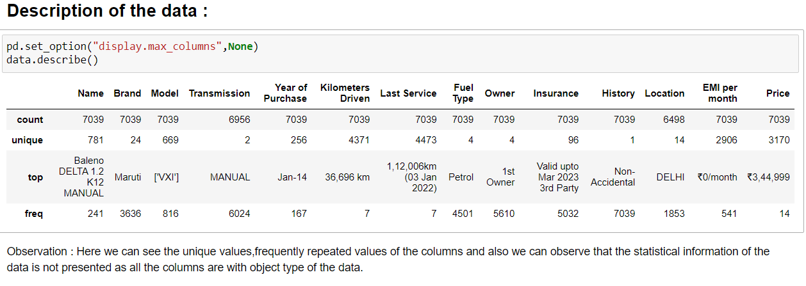
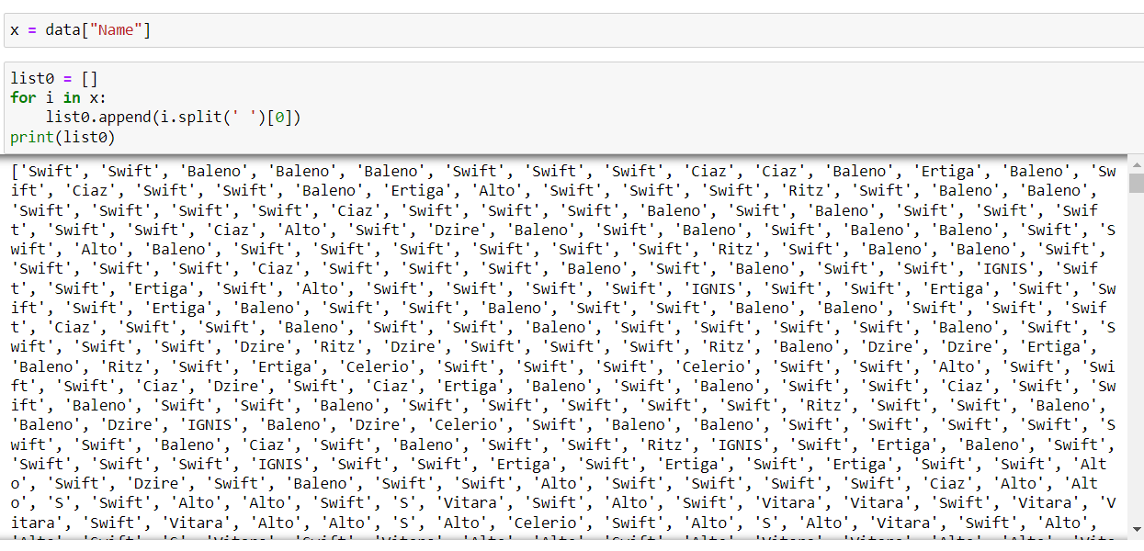
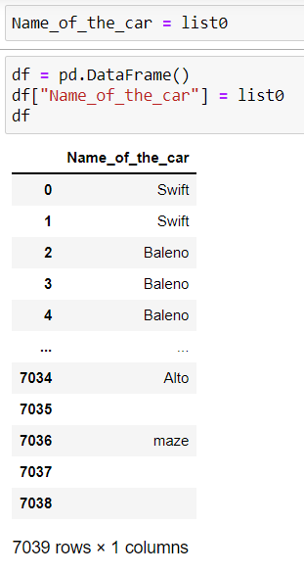
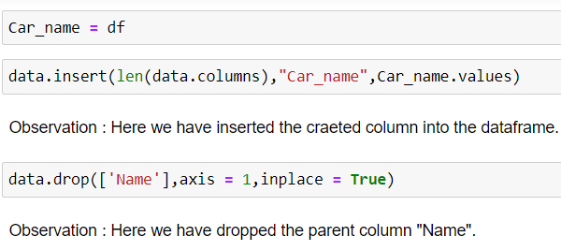
The dataset has only object datatype and so statistical description is not done over here.
Here we will see the pre-processing of the few of the columns.
Here the pre-processing of the data starts:

Slide 8
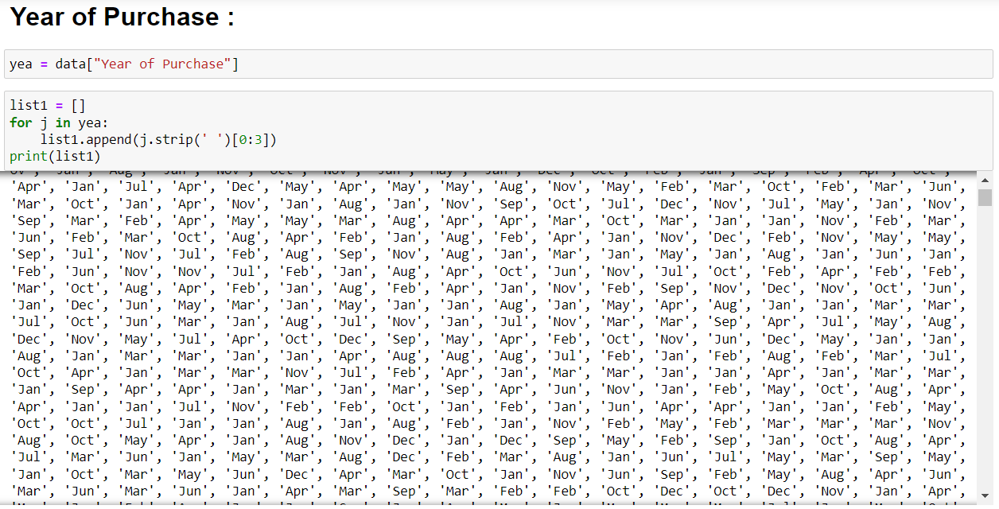
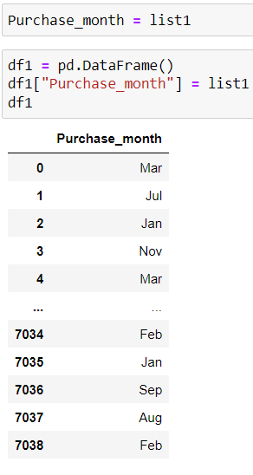
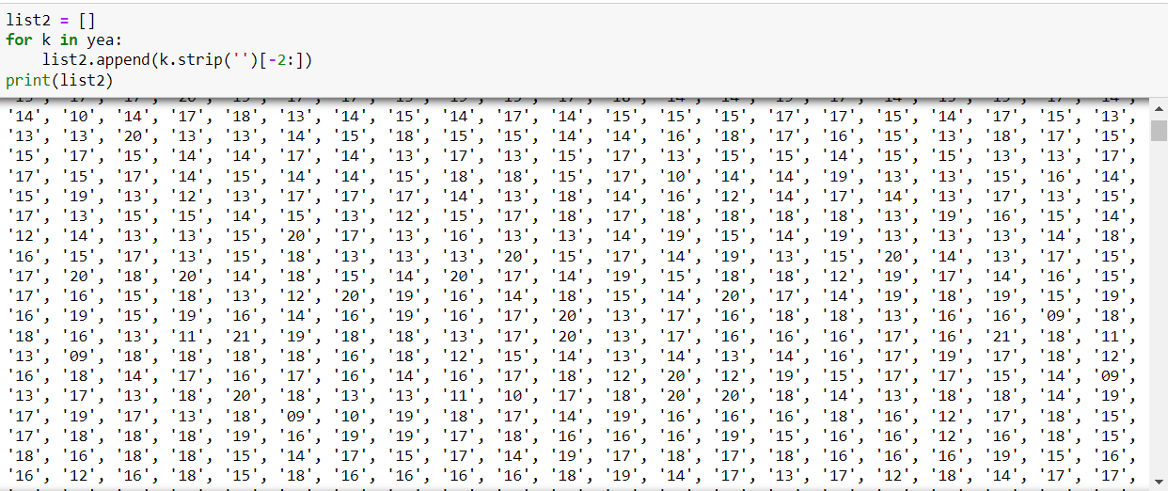
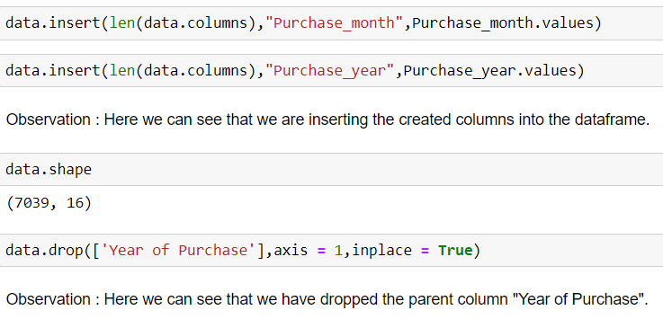
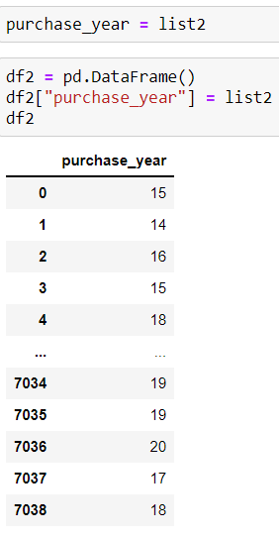
Here the new columns like “Purchase month” and “purchase year” are created and after creating these new columns the parent column is dropped.

Slide 9
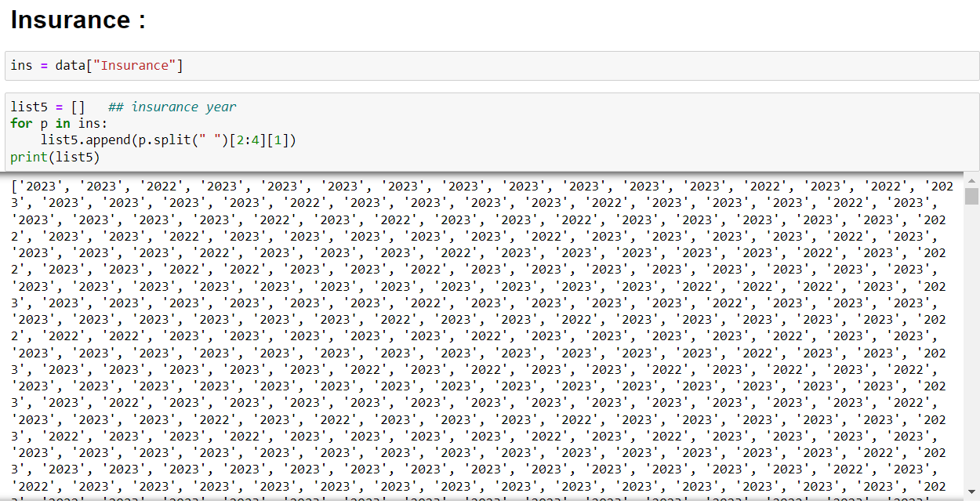
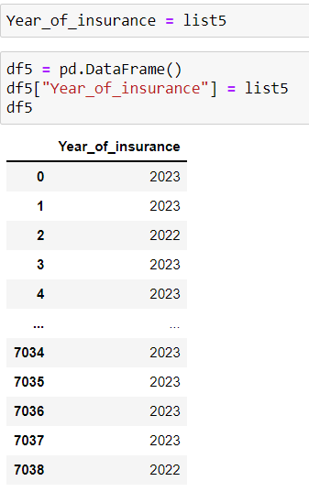
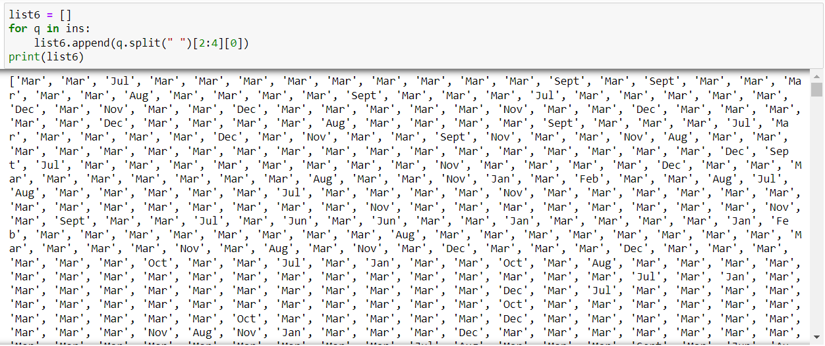
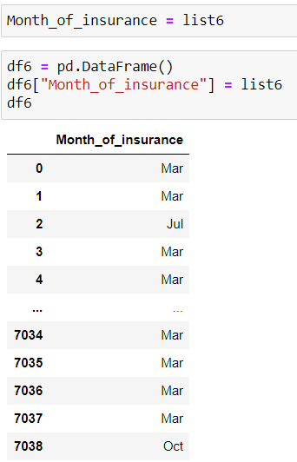
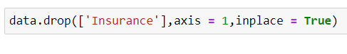
Here we have dropped the parent column after creating the new columns “Year of insurance” and “Month of insurance”.
These are the few columns which we have seen here for preprocessing, as these the other features which are required are pre-processed.

Slide 10
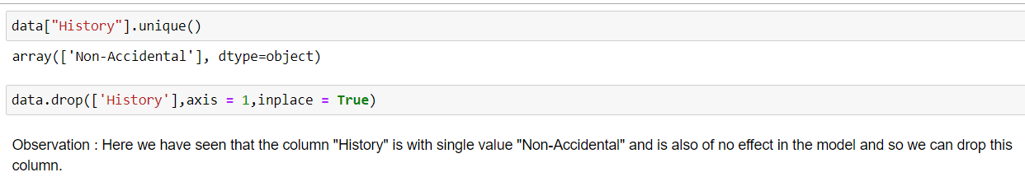
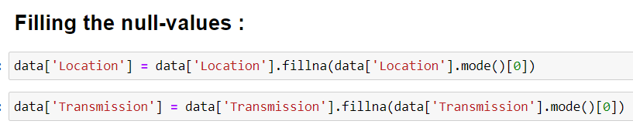
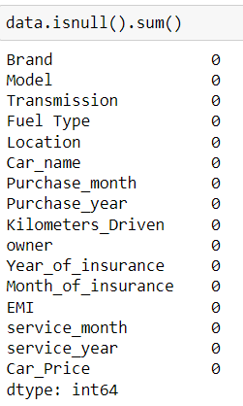
Now here we drop the unnecessary column “History” in which we have the same data in all the records and is not useful for our prediction and so we delete the column
Here we have filled the null values present in the feature data through mode values of the data.
Here we can see that we have finally succeeded in filling the null values of the features

Slide 11
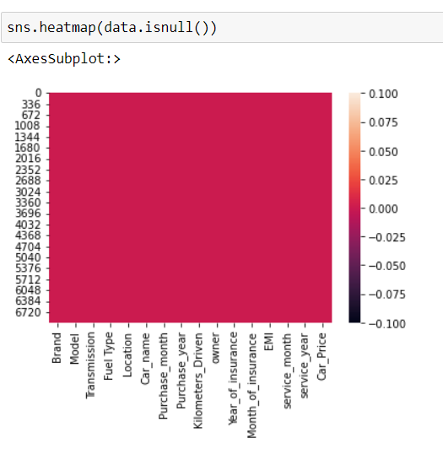
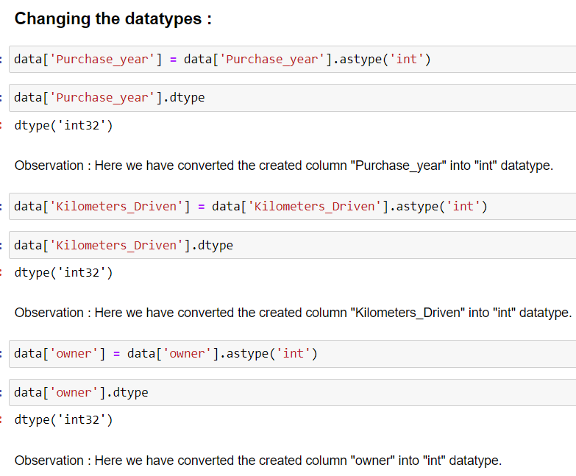
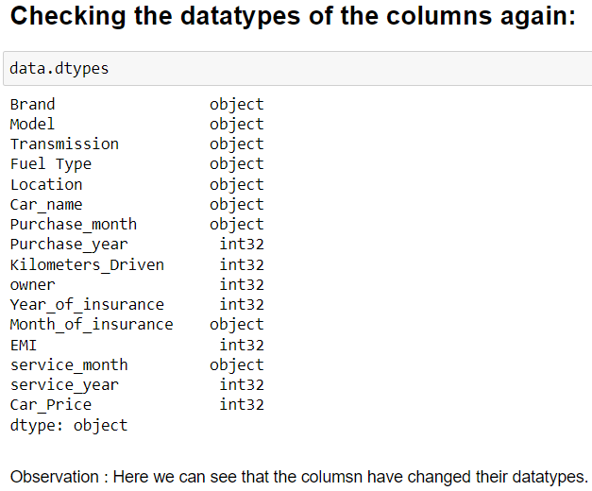
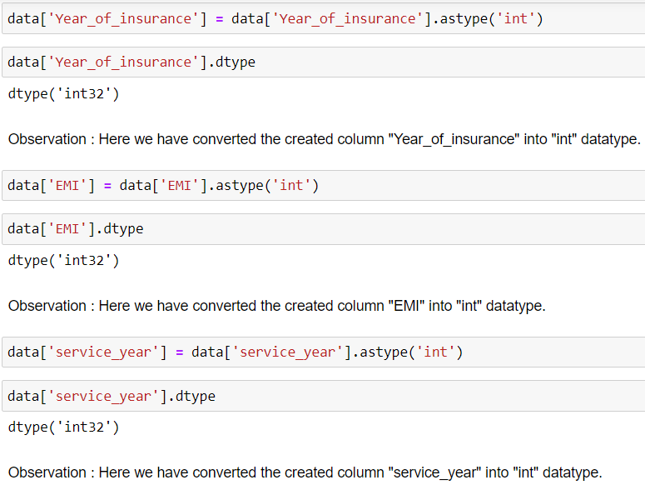
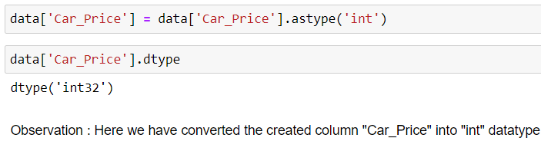
change the datatype of the columns :
Here we can see that there are no null values in our dataset now .
Here we can see that the datatypes of the features which are preprocessed and changed with their datatypes have changed.

Slide 12
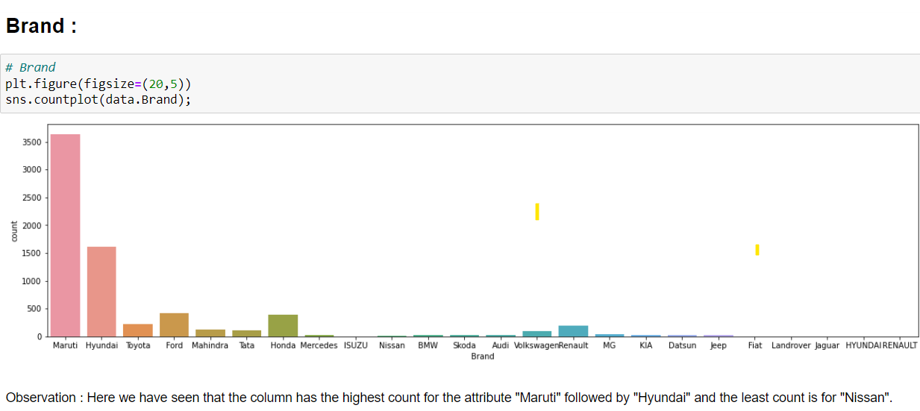
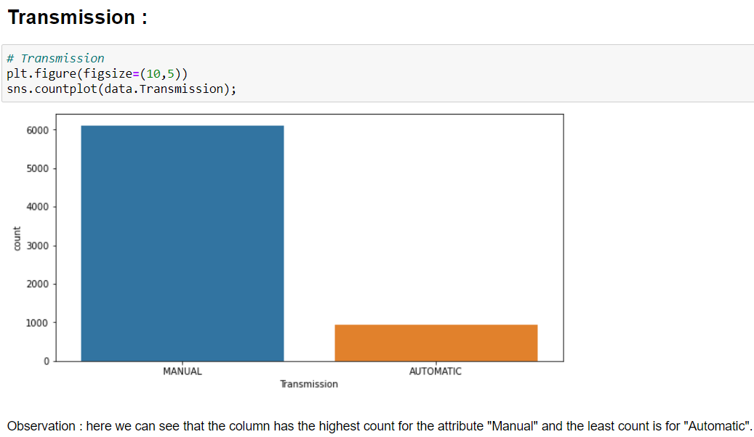
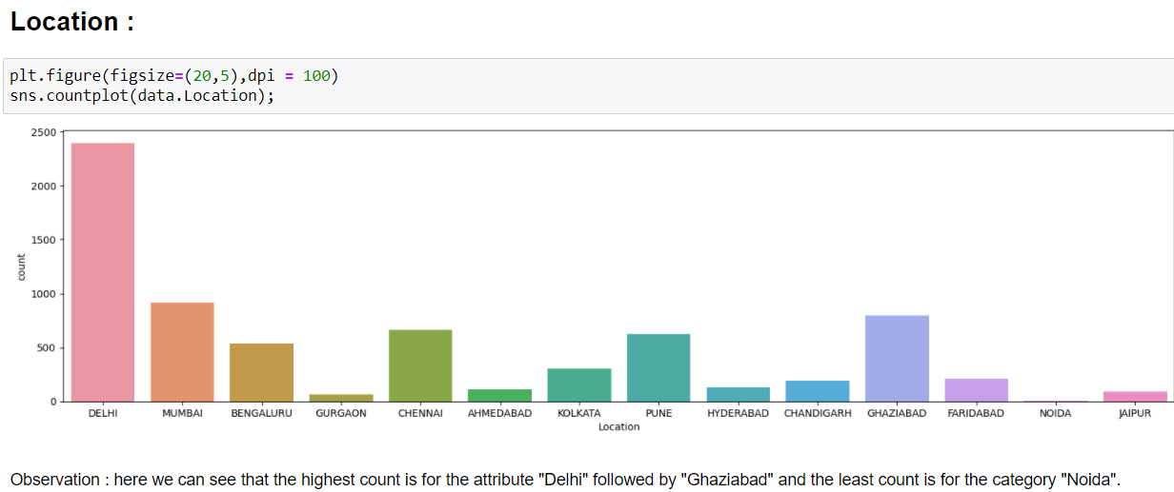
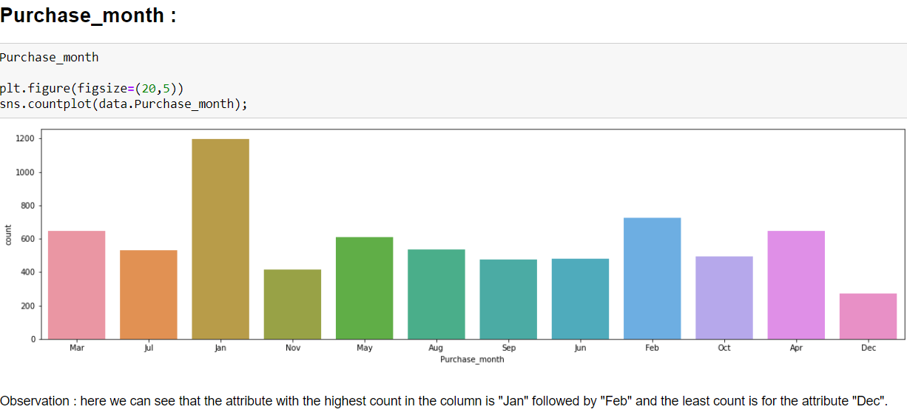
Visualization of the data: Univariate Analysis
Now here we will be going to visualize few of the features of our dataset.

Slide 13
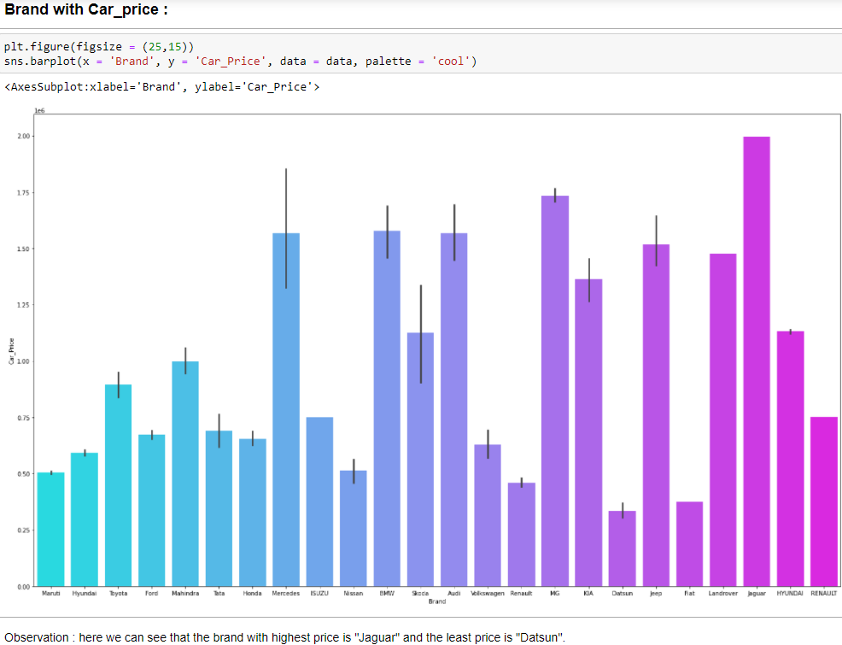
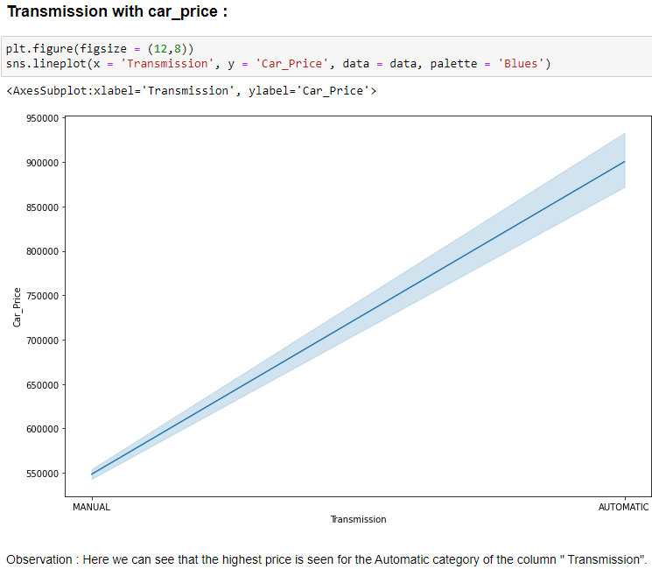
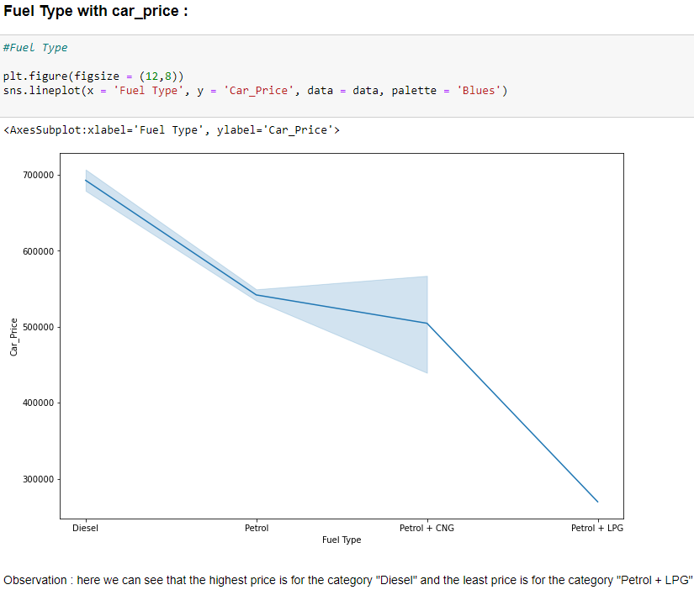
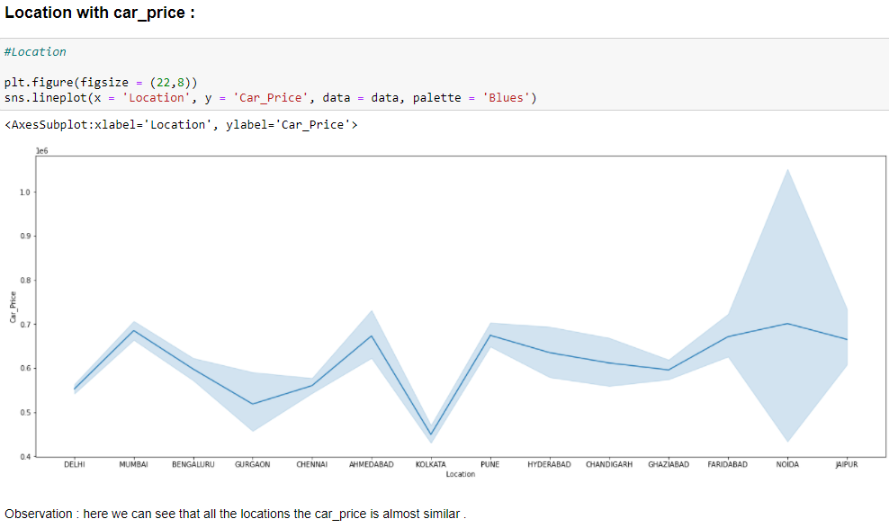

Slide 14
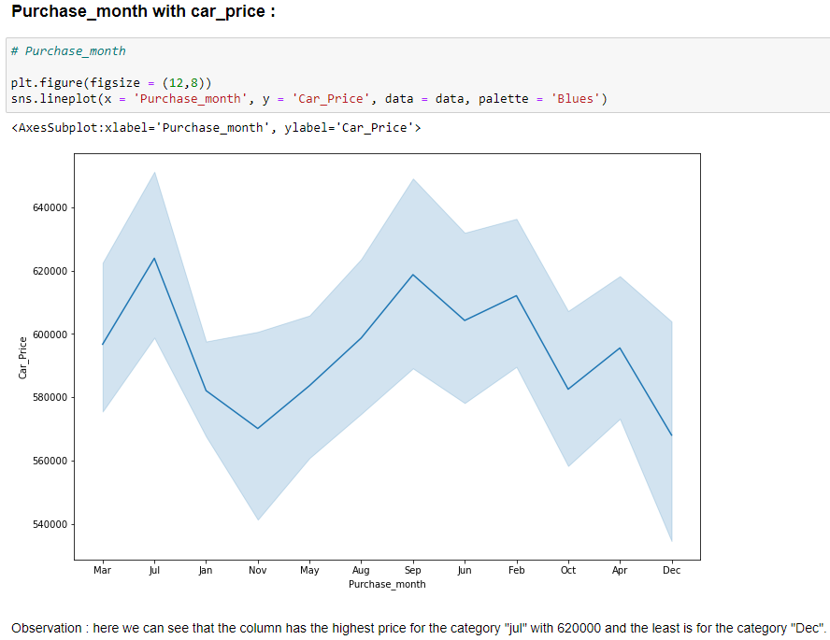
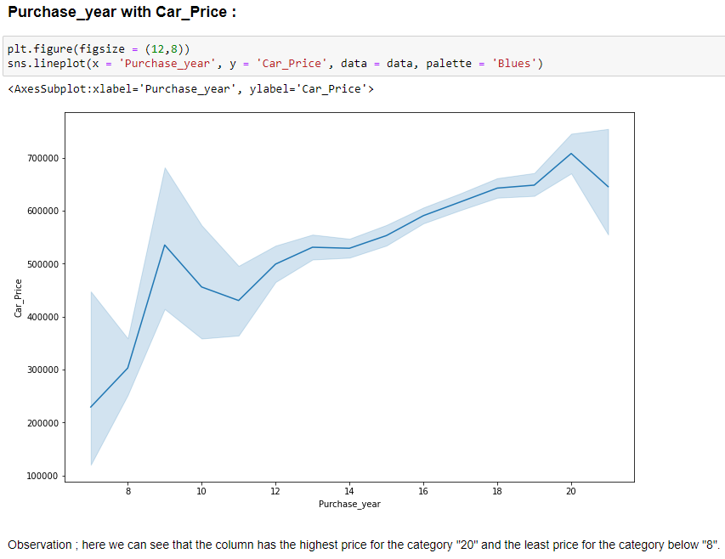
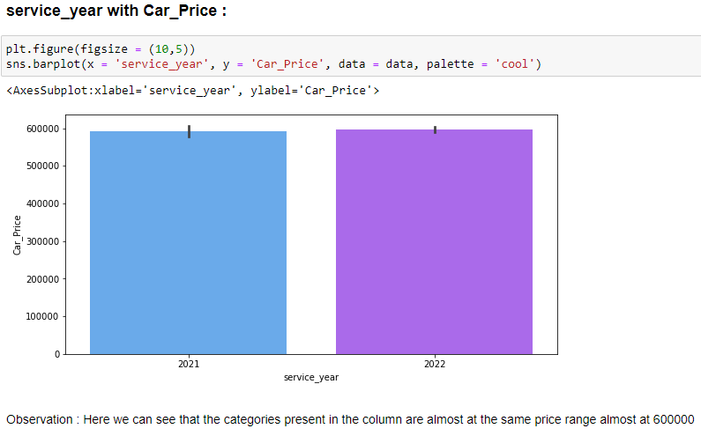

Slide 15
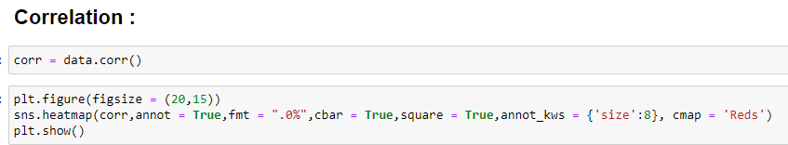
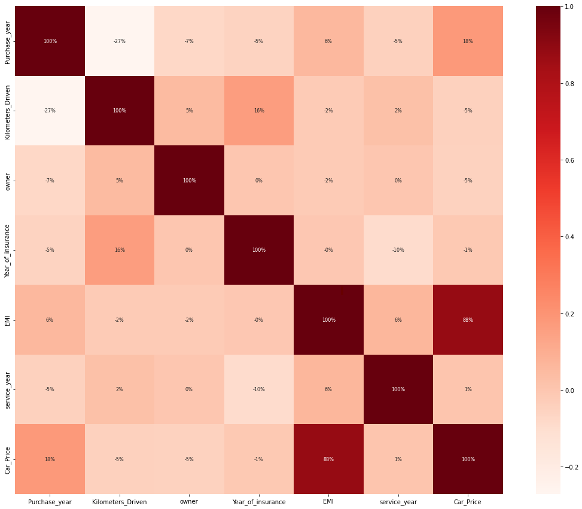
Here the correlation between the features and the variable can be checked and along with which the multicollinearity can also be detected and here the feature “EMI” has the high correlation with our label column.

Slide 16
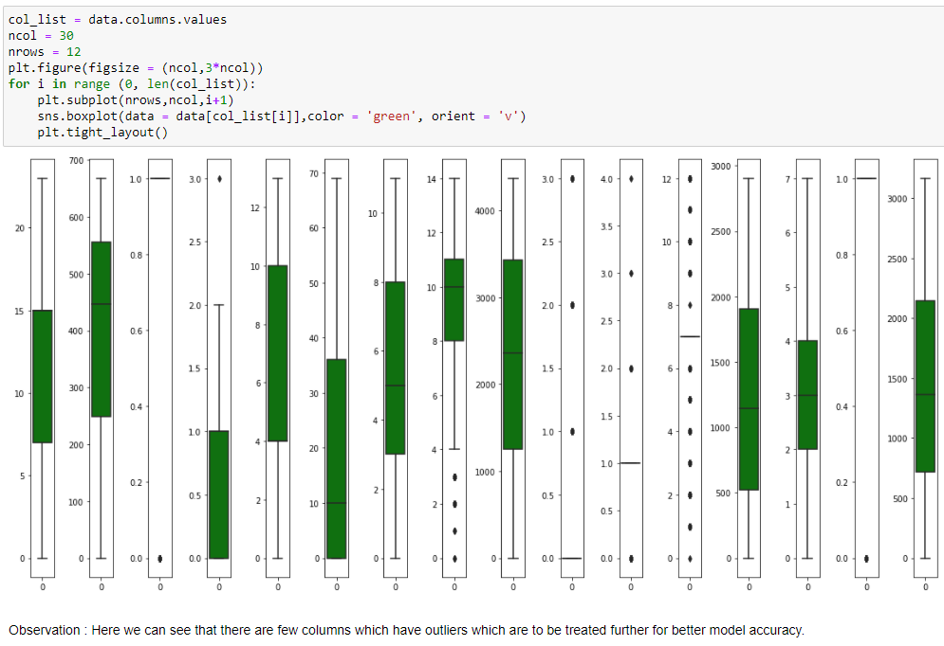
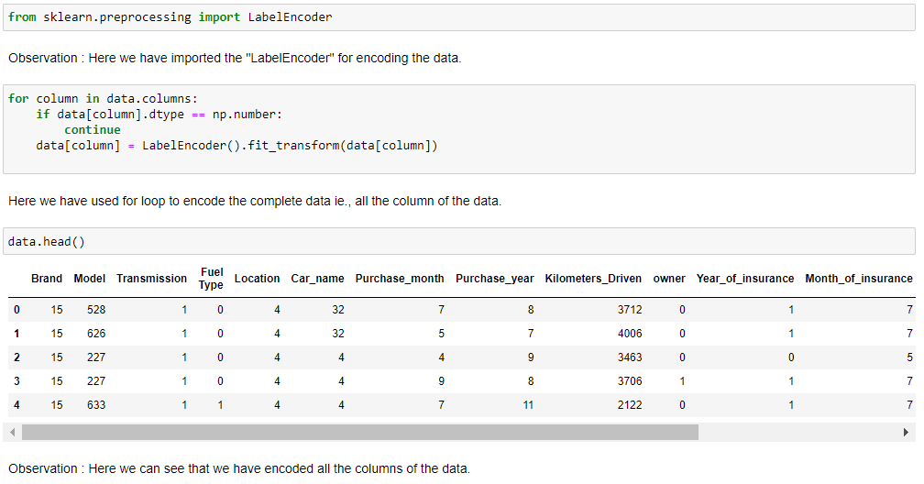
Now we will Check the outliers present in the data:
Encoding the data through Label Encoder:
Here we have encoded the data for further model building in which all the data present in the features are encoded accordingly.
Here we can see that the few features are with outliers and have to treated for better model accuracy.

Slide 17
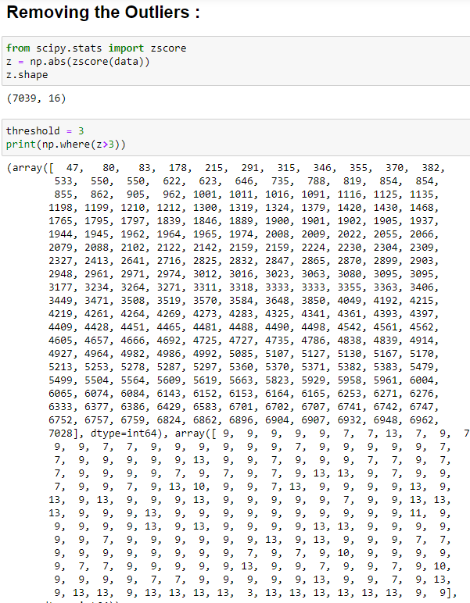
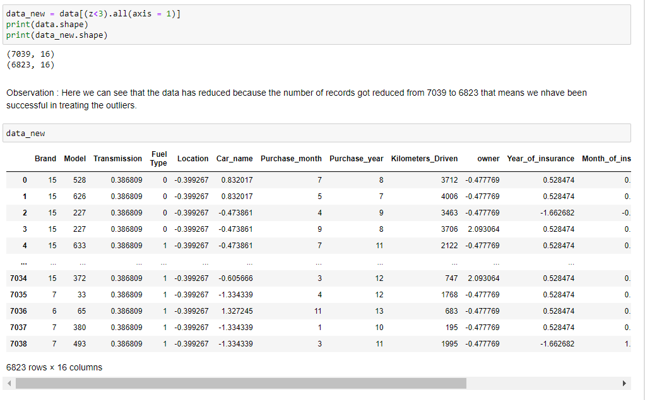
Here we will be removing the outliers through Z-Score method and here we have taken the threshold of 3 for removing the outliers to some extent.
Here we can see that the there is decrease in the number of records which indicates that there is change in outliers to some extent.

Slide 18
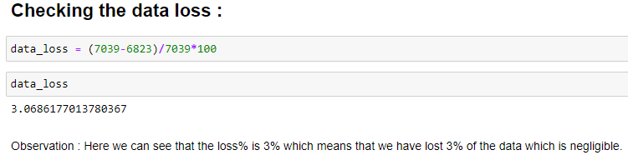
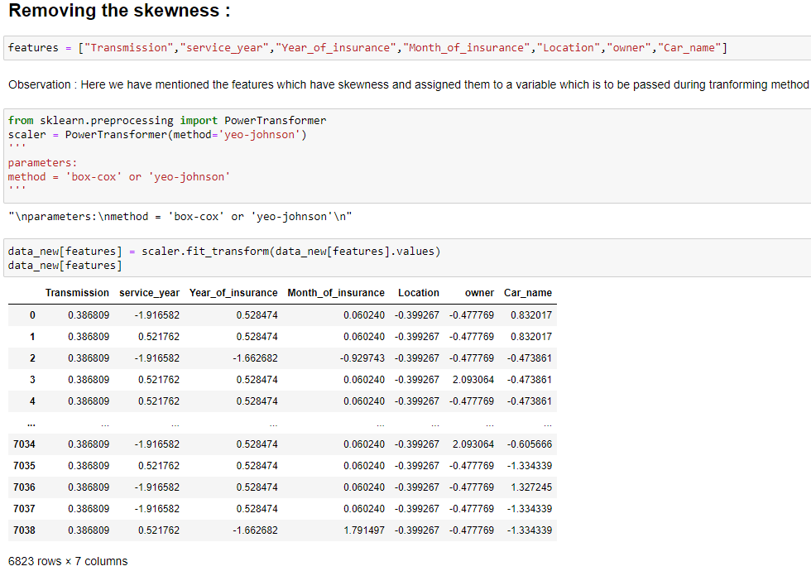
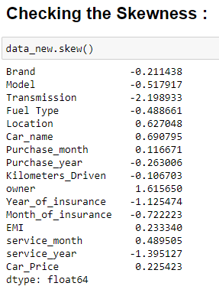
Here we have data loss of 3% which is negligible.
Here the data has skewness and the features are the combination of negative and positive skewness of which the features with negative skewness are more.
Here the features with skewness are passed through ”Power Transformer” method to reduce the skewness.

Slide 19
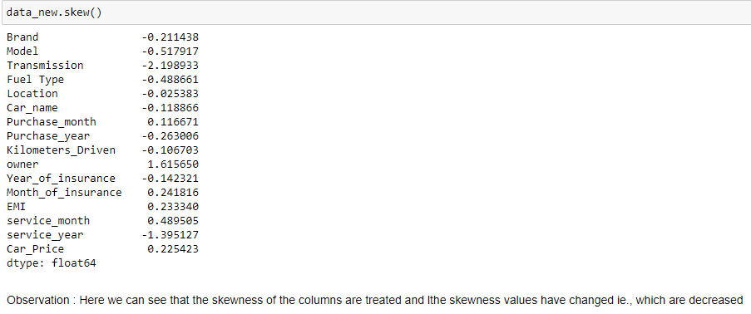
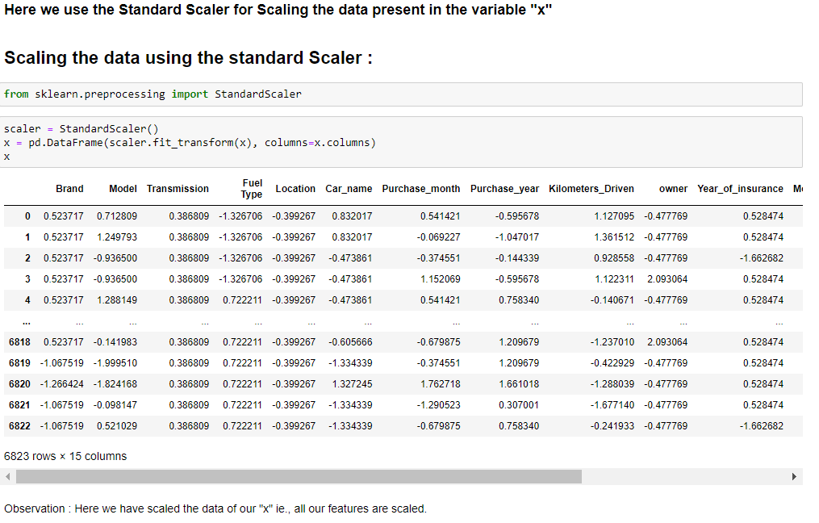
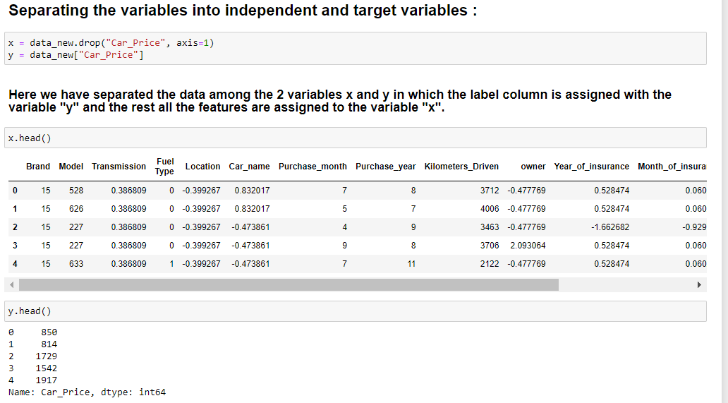
Now we can see the change in the skewness of the features of the data.
Here the features are separated between the variables x and y and the features are assigned to variable “x” which are scaled through Standard Scaler.

Slide 20


Here we have imported the necessary libraries for modelbuilding and splitting the data into train and test sets and now we will split the data at the maximum random state which we got ie., 7

Slide 21


Now here we import all the necessary model libraries.
I’m testing the results with the below algorithms. 1. Linear Regression 2. Random Forest Regressor 3. Decision Trees Regressor 4. KNN Regressor In order to test the model, I’m using r2 score and RMSE (Root Mean Squared Error), further in order to verify the model’s fit, I’m using cross validation score to identify the best model.

Slide 22




Slide 23


Observation: Here we can see that among all the models “Random Forest Regressor” has high CV Score.

Slide 24


Here we have saving our predicted model
Here we can see that the original and the predicted values can be presented over here and our best model accuracy is 98.4%

Slide 25
CONCLUSION:
We have successfully built a model using multiple models and found that the Random Forest Regressor model is the best model with a good accuracy.
Below are the details of the model’s metrics predicting the dataset • R2- score of 0.98 • RMSE of 108.88.
You can view the same from the visualizations on the correlation of independent variable over dependent variable (target) As we can see from the boxplot, I couldn’t remove all the outliers yet since the data is expensive, I have to proceed with the dataset with outliers.
Further, I couldn’t get skewness under control for few variables through couple of transformation techniques, yet I have proceeded with building the model. Looking at the heat map for correlation, I could see there were few independent variables which were correlated with each other, yet I have not removed any variable based on their correlation because multi-collinearity will not affect prediction.

Slide 26
Limitations of this work and Scope for Future Work:
Due to the presence of lot of outliers, we are unsure whether the model is going to perform well to a completely new dataset.
During data-collection, there are certain websites that do not provide the necessary information on the used car due to which the data collected was not precise which had to pre-processed for building a better model.
Other than these above limitations, I couldn’t find more scope for improvement.

Slide 27


